Slide 1
Theme: Social Impact
Project:
YOUTH UNEMPLOYMENT IN AFRICA.

Slide 2
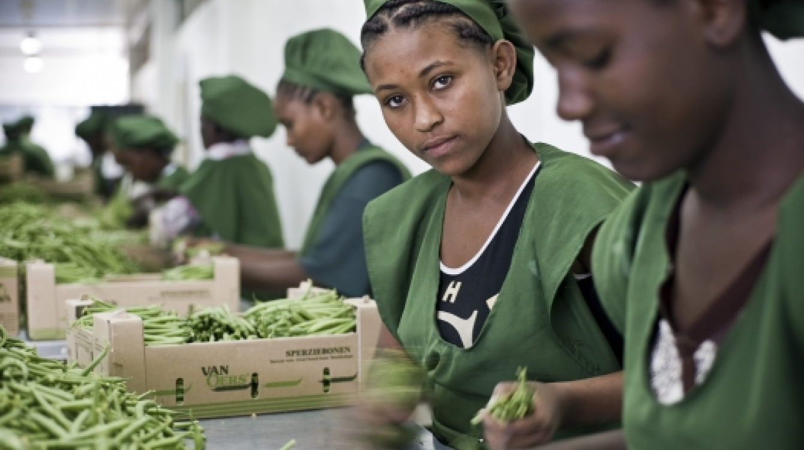
Young workers in Addis Ababa, Ethiopia, packing beans for export. Photo: Panos/Sven Torfinn
Notes:
Young workers in Addis Ababa, Ethiopia, packing beans for export. Photo: Panos/Sven Torfinn

Slide 3
INTRODUCTION:
Imagine if we could build a future where every young person in Africa has the opportunity to reach their full potential, to contribute to their communities and to make a positive impact on the world. This future is possible, but it requires bold action and innovative thinking. One of the most pressing challenges we face in realizing this future is youth unemployment. In Africa, millions of young people are trapped in a cycle of poverty, unable to find meaningful work and unable to contribute to their communities. We need to think differently about how to create a better future for these young people.

Slide 4
In Africa, youth unemployment is a significant problem, affecting millions of young people. According to the International Labor Organization, more than half of young people in sub-Saharan Africa are unemployed or working in the informal sector, meaning they have little job security and few prospects for advancement. Young women are particularly affected, with unemployment rates as high as 65% in some countries. In addition, many young people lack the basic skills needed to find meaningful work, and face numerous barriers to entering the formal labor market.

Slide 5
This crisis has significant implications for individuals and their families, as it contributes to poverty, crime, and social unrest. If left unaddressed, this crisis could have a long-term negative impact on Africa's development and economic growth. In addition to the overall lack of economic opportunities, many young people in Africa, including university graduates, face significant barriers to finding work. Many lack the soft skills required for employment, such as communication, teamwork, and problem-solving skills. There is also a mismatch between the skills taught in schools and the skills demanded by employers, which means many young people are unable to find work that matches their qualifications.

Slide 6
The World Bank has highlighted the issue of youth unemployment as a major challenge for developing countries, including in Africa. According to the World Bank, "youth unemployment and underemployment not only undermine economic growth, but also result in a generation of frustrated young people who lack the skills needed for a productive and fulfilling life, which can lead to increased crime and violence".

Slide 7
Additionally, the United Nations has stated that "youth unemployment is a global issue that has serious consequences for young people, their communities and society as a whole". The United Nations has identified youth unemployment as one of the most pressing development challenges in the world today. The UN has released several reports on this issue, including the "World Youth Report" and the "Global Employment Trends for Youth" report. These reports highlight the scale of the problem and offer recommendations for addressing it.

Slide 8
The impact of youth unemployment is far-reaching, affecting not only the individual but also their family and community. In terms of individual impacts, unemployment can lead to feelings of low self-esteem and a lack of purpose, which can have a negative impact on mental health.Young people who are unemployed are also more likely to experience poverty, which can have a significant impact on their quality of life. Additionally, unemployment can lead to a cycle of poverty, as it becomes increasingly difficult for young people to find work and break out of the cycle.

Slide 9
Some of the countries in Africa with the highest rates of youth unemployment include South Africa, Lesotho, Zimbabwe, Mozambique, Swaziland, Namibia, and Uganda. According to the World Bank, in South Africa, for example, the youth unemployment rate is around 50%, and it is even higher in some provinces, such as Limpopo, where it reaches over 60%. The high rates of youth unemployment in these countries have been attributed to a number of factors, including a lack of economic opportunities, a mismatch between education and employment, and a lack of skills development.

